Slide 1
Debugging
A bug is an error, flaw, or unexpected behavior in a program that causes it to function incorrectly or produce incorrect results.
Debugging is the process of identifying, analyzing, and fixing errors in your code.
Knowing how to debug:
Ensures your code runs correctly.
Improves program efficiency.
Helps develop a deeper understanding of your code.

Slide 2
Identify the Bug in MATLAB
Common Types of Errors
Syntax
Logic
Code runs without crashing but produces incorrect results
Mistakes in the code structure
Runtime
Errors that occur while the code is running

Slide 3
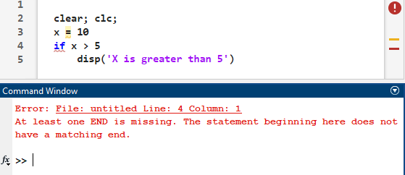
Common Types of Errors in MATLAB
1. Syntax Errors: Mistakes in the code structure (e.g., missing parentheses, misspelled commands).
MATLAB detects these errors before running the code.
Provides clear error messages pointing to the line and type of issue.
Syntax Error Warning
Code Analyzer Indicators
Location of error/warning
Red = Syntax Error
Yellow = Suggestion
Error Message
(explains the error and gives insights on how to fix it)

Slide 4
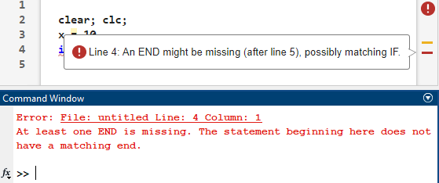
Common Types of Errors in MATLAB
1. Syntax Errors: Mistakes in the code structure (e.g., missing parentheses, misspelled commands).
MATLAB detects these errors before running the code.
Provides clear error messages pointing to the line and type of issue.
You can hover your mouse in the right margin to check each warning.
The Code Analyzer Indicators allow us to see the location of our errors at once. Unlike the Command Window Error message, which only outputs the first error it encounters

Slide 5
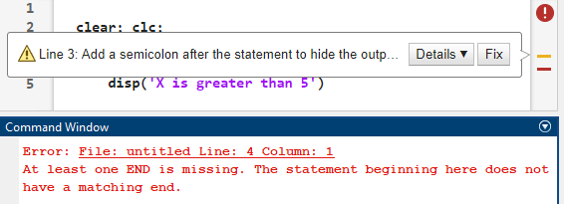
Common Types of Errors in MATLAB
1. Syntax Errors: Mistakes in the code structure (e.g., missing parentheses, misspelled commands).
MATLAB detects these errors before running the code.
Provides clear error messages pointing to the line and type of issue.
Yellow warnings help developers write better, more efficient, and more maintainable code. These warnings are not errors but highlight potential issues or improvements.
Promote Best Practices
Improve Code Efficiency
Enhance Code Readability and Maintainability
Identify Potential Bugs
Encourage Future Compatibility

Slide 6
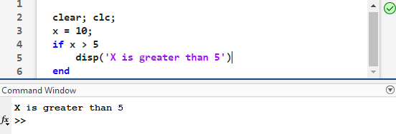
Common Types of Errors in MATLAB
1. Syntax Errors: Mistakes in the code structure (e.g., missing parentheses, misspelled commands).
MATLAB detects these errors before running the code.
Provides clear error messages pointing to the line and type of issue.
Example:
No Warnings
In line 4, we have an if statement that is missing an “end” (as required by MATLAB's syntax rules).
We want to add the “end” after the if statant logic (x>5?) and the action we want to take (display X > 5).
Therefore, we add the “end” in line 6 and we resolved all syntax errors.
According to the Command Window Error Message, and the Code Analyzer Indicators, we should:
Check the missing “end at line 4
Add semicolon “;” in line 3

Slide 7
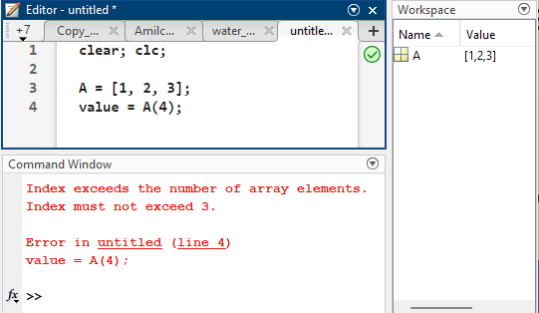
Common Types of Errors in MATLAB
2. Runtime Errors: Errors that occur while the code is running.
Code starts running but fails at a specific point.
Often caused by invalid operations (e.g., division by zero, invalid indexing, matrix mismatch)
Runtime errors occur during script execution, stopping MATLAB when encountered. Unlike syntax errors, which are detected before execution, runtime errors are unpredictable and must be fixed one by one as they arise.
Note that MATLAB Code Analyzer has a check mark, but we still have a runtime error.

Slide 8
Common Types of Errors in MATLAB
2. Runtime Errors: Errors that occur while the code is running.
Examples:
Indexing Error: The A vector has size (1x3)
A(1) = 1
A(2) = 2
A(3) = 3
However, there is no A(4), so it provides the error shown in the Command Window
This type of error is straightforward to identify in simple cases, but it can be harder to detect in more complex scenarios, such as within an iteration of a for loop

Slide 9
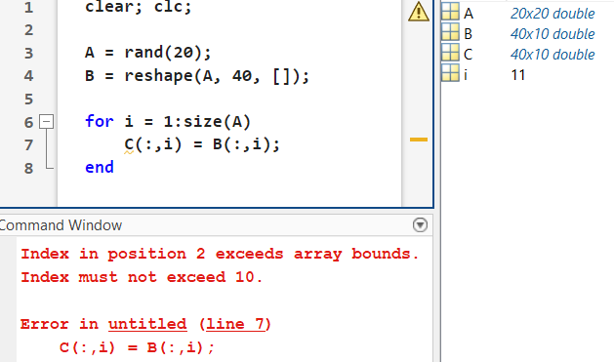
Common Types of Errors in MATLAB
2. Runtime Errors: Errors that occur while the code is running.
Indexing Error (in loop):
This example demonstrates how a hidden bug can arise in a script:
B is a matrix of size (40x10).
The loop iterates i from 1 to the size of A, which is 20x20, interpreted as 1 to 20.
Key Issue:
On line 7, the error occurs because the index i exceeds the number of columns in B (which is 10).
Specifically, the last iteration (i = 11) attempts to access B(:,11), which is out of bounds.
Examples:

Slide 10
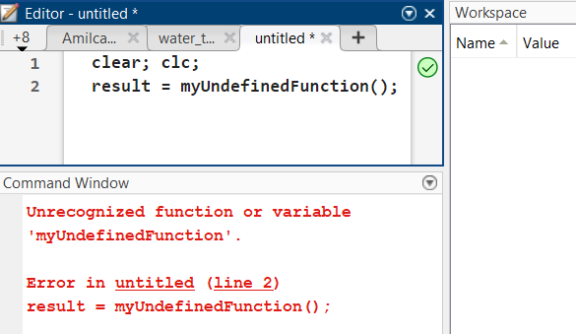
Common Types of Errors in MATLAB
2. Runtime Errors: Errors that occur while the code is running.
Examples:
Undefined Variables or Functions
Description:
Happens when a variable or function is called without being defined or in the wrong context.

Slide 11
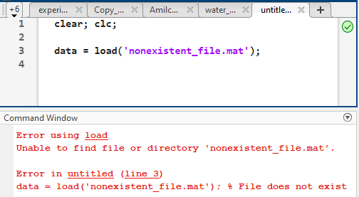
Common Types of Errors in MATLAB
2. Runtime Errors: Errors that occur while the code is running.
Examples:
File or Path Errors
Triggered when a required file cannot be found or accessed.
You must ensure:
The file exists
MATLAB knows where the file is located
E.g: Adding absolute path in MATLAB
addpath(genpath('C:\Users\jose\Datas’));
(adds the folder “Datas” and all its subfolders)

Slide 12
Common Types of Errors in MATLAB
2. Runtime Errors: Errors that occur while the code is running.
And more types:
Input Error: using wrong data type (E.g. Expect a numeric input, but a string was used instead)
Hardware Error: Trying to connect to a disconnected sensor.
Dimension Mismatch (E.g. Matrix multiplication)
Memory Error: creating a matrix too large to fit in memory.
…

Slide 13
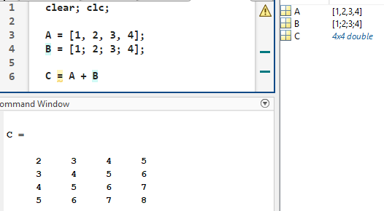
Common Types of Errors in MATLAB
3. Logical Errors: Code runs without crashing but produces incorrect results.
Hardest to spot because there are no error messages.
Requires careful examination of logic and expected outputs.
Example:
Operations between row and column vector can lead to different results than intended.
In this case, MATLAB is broadcasting these matrices of same size but different shape.
This error can lead to future Runtime errors.

Slide 14
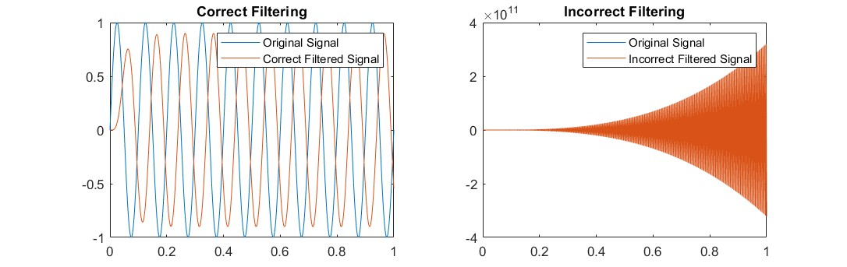
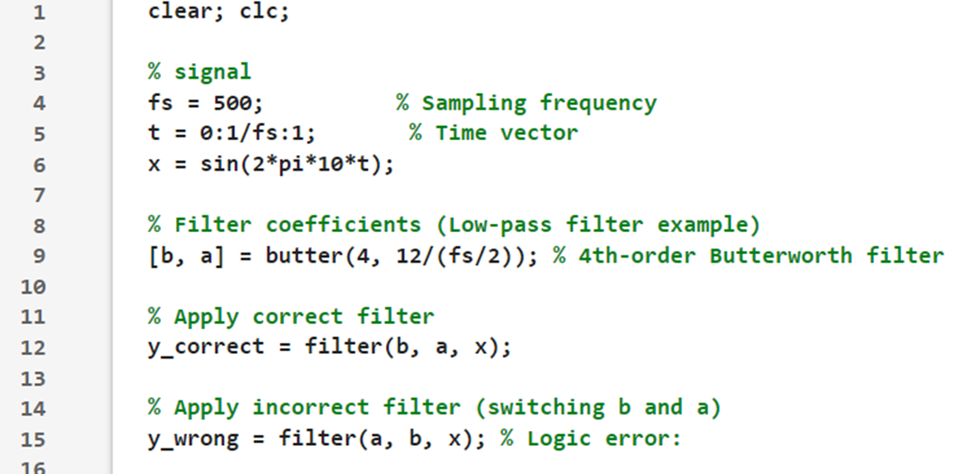
Common Types of Errors in MATLAB
3. Logical Errors: Code runs without crashing but produces incorrect results.
Example:
The following code produces no errors, but upon visualizing the data, we see that the filtered signal is distorted. This happened because the filter function was not used correctly, and the applied filter was not a low-pass filter

Slide 15
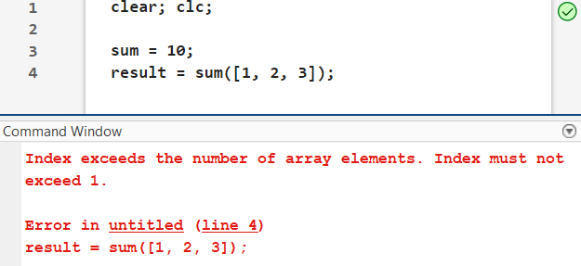
Common Types of Errors in MATLAB
3. Logical Errors: Code runs without crashing but produces incorrect results.
Example:
Override the Built-In Functionality:
MATLAB prioritizes variables in the current workspace over built-in functions.
If you create a variable with the same name as a built-in function, MATLAB will treat it as a variable and you lose access to the original function.
This Runtime error was produced by overriding the Built-In Function “sum”, with a variable “sum = 10”

Slide 16
Common Types of Errors in MATLAB
3. Logical Errors: Code runs without crashing but produces incorrect results.
More Examples:
Mismatched Units
Omitting Edge Cases
Invalid Input Validation
Incorrect Output Handling
Splitting a matrix at the wrong indices
Incorrect Loop Bounds: running a loop for one too many or too few iterations
Overwriting Variables: accidentally overwriting a variable, leading to loss of important data during execution.
Incorrect Formula
Incorrect Indexing
Misusing Logical Operators. e.g. Misusing & (element-wise AND) instead of && (short-circuit AND)
…

Slide 17
Dealing with Bugs in MATLAB
Variable Explorer
Breakpoints
Command Window
Pause Script on desired location
Using commands not included on the main script
Debugging Tools
Editor Debugging Features
Matlab Documentation, Forums, and AI
Step
Step In/Out
Pause on Errors
Workspace

Slide 18
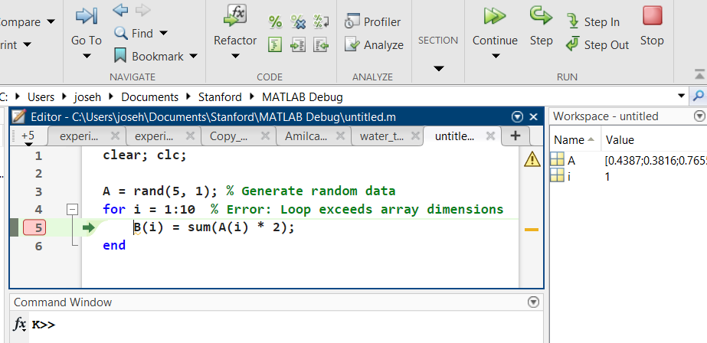
Debugging Tools
Breakpoints: Pause execution at specific lines to inspect variables and flow.
Click on the line number in the left margin where you want to pause the script. MATLAB will enter debugging mode when the code execution reaches that line.
You can set multiple breakpoints and even add them while debugging. Additionally, you can add breakpoints inside functions called by your script.
Pressing Continue will bypass the current breakpoint and execute the rest of the script. If another breakpoint is encountered, the script will pause again.

Slide 19
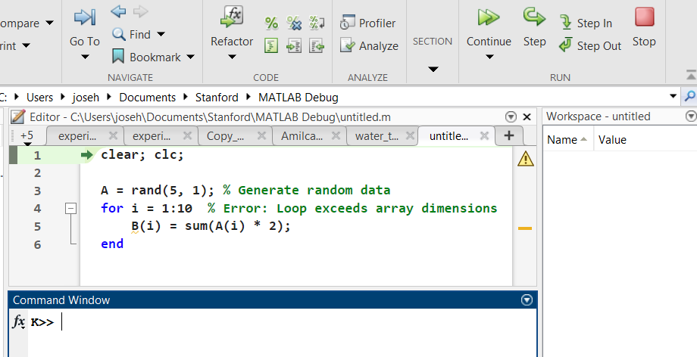
Debugging Tools
There are many ways to enter “Debugging Mode”:
Setting breakpoints
Pressing “Step” instead of “Run”
Editor Debugging Features:
Step: execute the current line of code and move to the next line.
Step In: Enter the function or sub-function being called to debug it line by line.
Step Out: Exit the current function and return to the calling function or scrip.
Pause on Errors: on the “Run” dropdown, you can select Pause on Error. MATLAB will show exactly where the running error is produced.

Slide 20
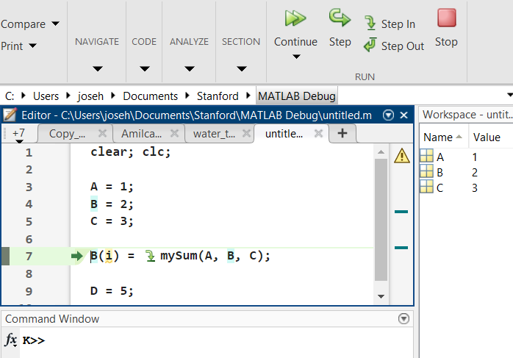
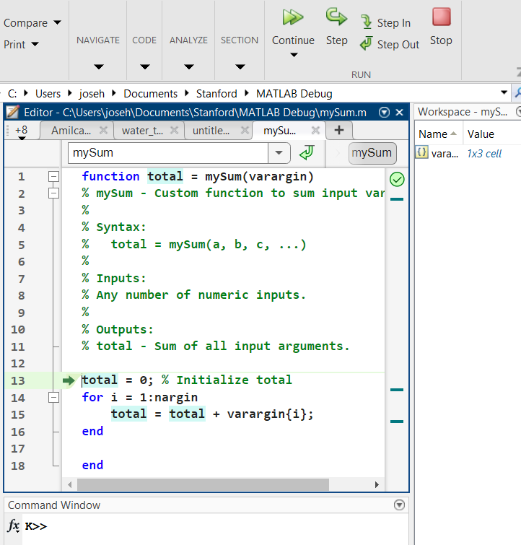
Debugging Tools
We are now inside “mySum.m”
The workspace will act as a new instance (you won't have access to the main script variables)
Example: what is going on with function “mySum”?
Use “Step In” in line “7”
Notice the “Step In arrow”. It indicates that you can step into that function

Slide 21
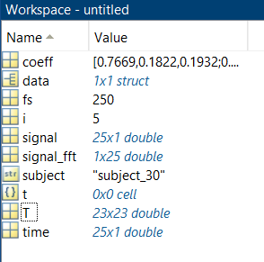
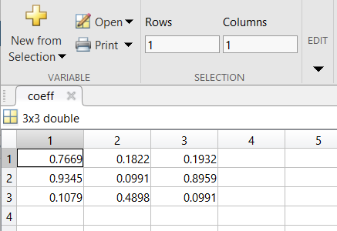
Debugging Tools
Workspace: displays variables currently in memory, their sizes, and their types.
Set a breakpoint in your code. When execution pauses, inspect variables in the Workspace.
The Workspace cannot display certain types of data, such as long arrays or structured data.
Variable Explorer: A tool for interactively inspecting and editing variables.
Double-click on a variable to explore its values.
Inspect a variable to ensure it contains the expected data before being used in a calculation.
The Variable Explorer may not visualize certain data types, such as 3D or 4D arrays.
e.g. Double click “coeff” to open variable explorer
Now you can edit values in coeff if necessary

Slide 22
Debugging Tools
Command Window: interactive interface to test, inspect, and modify code while the execution is paused.
Command Window will show “K>>” when on debugging mode.
Run commands not included in the main script. This is useful for avoiding unnecessary clutter in your code with commands that are only needed during debugging.
Set the breakpoint where you want the script to stop, and to start inspection.
Inspect variables:
Display: disp(X) or X
Dimensions: size(X)
Y = function(X)
etc …
Visualize data:
plot(X)
Imagesc(Y)

Slide 23
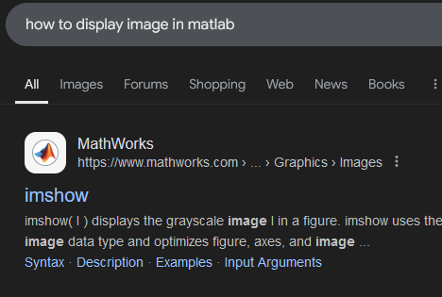
Debugging Tools
MATLAB Documentation: Official resource to understand MATLAB functions, syntax, and examples.
When to Use:
To check proper syntax.
Understand inputs, outputs, and options for functions.
Find specific examples and usage tips.
Use the doc or help commands:
doc imshow % Opens the documentation for the 'plot’ function in matlab
help sum % Displays a brief description in the Command Window
edit imshow % Opens the .m file containing the function

Slide 24
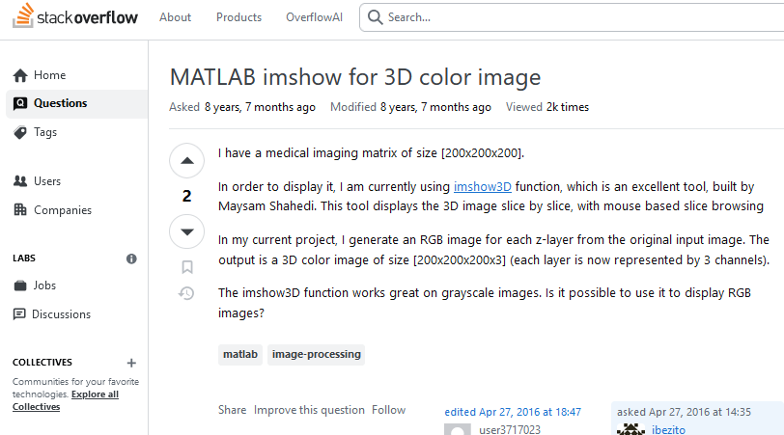
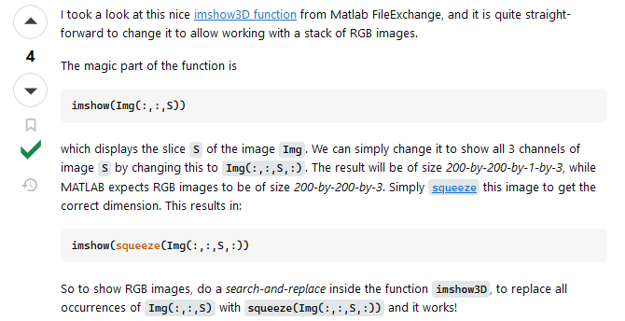
Debugging Tools
Forums: Supplement MATLAB Central with additional community discussions.
Stack Overflow:
Extensive Q&A library for programming-related issues.
Search: MATLAB <your error or question>
Reddit: Subreddits like r/matlab for informal discussions and help
Search Queries:
"How to fix ‘singular matrix’ error in MATLAB?"
"Best way to debug a for loop in MATLAB?"

Slide 25
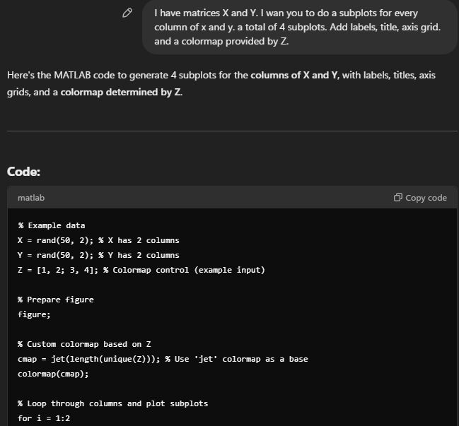
Debugging Tools
Using AI Tools like ChatGPT:
How to use:
Get quick and clear explanations for syntax, runtime errors, and conceptual doubts.
Provide a detailed question with your code and error message.
"What does ‘Subscript indices must either be real positive integers or logicals’ mean in MATLAB?“
For quick debugging.
When you need a simplified explanation of an error message.
When you don’t understand what a certain line of code do.
Automate simple scripting

Slide 26
Debugging Tools
Using AI Tools like ChatGPT:
How “NOT” to use:
ChatGPT is good at simple and well documented coding tasks. However, it is not fool prove and is prone to Logical Errors and hidden bugs.
Do not:
Copy-Pasting Code Without Understanding It.
Expect AI to Debug Without Full Context.
Using ChatGPT for Highly Specialized MATLAB Toolboxes.
Over-Relying on AI for Theoretical Concepts.
Assuming AI Knows Your Entire Workflow.

Slide 27
Debugging Process Overview:
Identify the Error: Use MATLAB’s error messages.
Set Breakpoints: Pause execution to examine code behavior.
Step Through Code: Navigate line-by-line to observe changes in variable values.
Inspect Variables: Use the workspace or command window to check for unexpected values.
Fix and Test: Modify the code and re-run to ensure the issue is resolved.
Best Practices for Debugging
Write clear and concise code.
Use meaningful variable names.
Test small sections of code frequently.
Document your code for readability.
Use MATLAB’s built-in debugging tools effectively.
Learn to interpret error messages accurately.

Slide 28
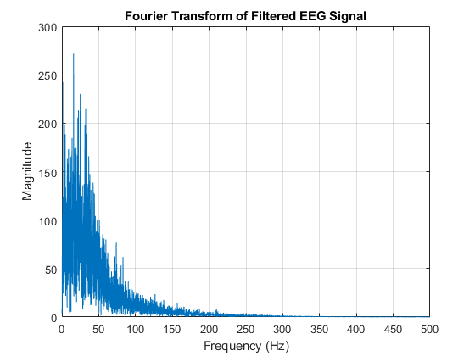
Tutorials
Correct Final Output
beginner_debugging_tutorial.m
A step-by-step guide to help you get familiar with MATLAB debugging tools and practices. You will solve basic Syntax, Runtime, and Logic Errors.
Task: Recreate the image shown on the right.
Instructions:
Fix the Syntax Errors (you can’t run the file until these errors are resolved).
Use Step instead of “Run” to execute the code line by line.
Use Breakpoints to pause execution and identify the bugs as you progress.

Slide 29
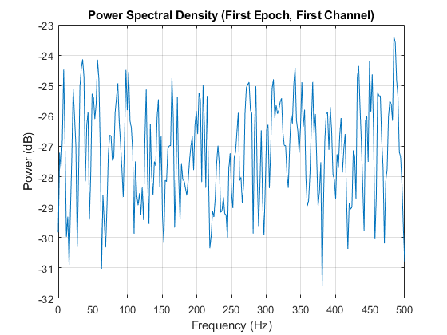
Tutorials
Correct Final Output
intermediate_debugging_tutorial.m
A guide to solving more complex errors and stepping into buggy functions.
Task: Recreate the image shown on the right.
Instructions:
Fix the Syntax Errors (you can’t run the file until these errors are resolved).
Use Step instead of “Run” to execute the code line by line.
Use Breakpoints to pause execution and identify bugs as needed.
Use visualizations and outputs in the Command Window to verify that the code behaves as expected and follows the intended flow.

